Slide 1
Random variable
Continuous r.v.
All possible values
form an interval of
positive length.
They can’t be arranged
as a sequence.
Discrete r.v.
Possible values are
Finite or countably
infinite.
They can be arranged
as finite or infinite seq.

Slide 2
Generally random variables are denoted by capital letters X, Y, Z etc or X₁, X₂ etc whereas their possible values are denoted by the corresponding lower case letters x, y,z or x₁, x₂ etc. respectively.

Slide 3
Discrete Probability density
Definition : The density function of a discrete random variable X is the function f defined by
f(x) = P(X=x) for all real x.

Slide 4
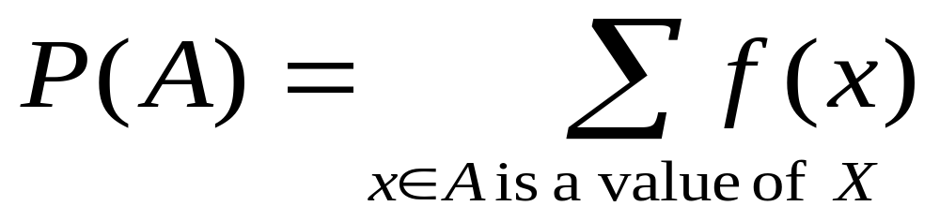
From the density, one can evaluate the probability of any subset A of real numbers (I.e. event):
Conversely if we are given probabilities of all
events of a discrete random variable, we get a
Density function.

Slide 5
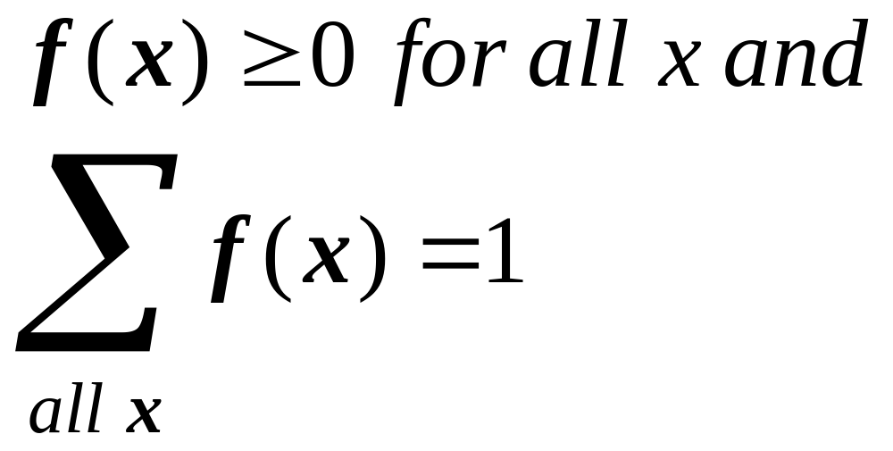
The necessary and sufficient condition for a
function f to be a discrete density function :

Slide 6
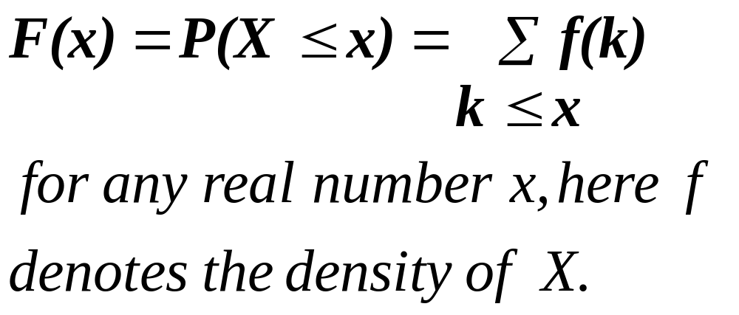
The cumulative distribution function F of a discrete random variable X, is defined by

Slide 7
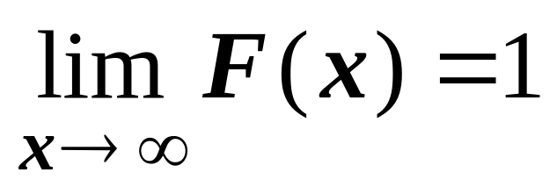
The density and cumulative distribution function determine each other. If random variable takes integer values then f(n) = F(n)-F(n-1).
In such situation, cumulative distribution function of a discrete random variable is a step function, its values change at points where density is positive.
Note that F(x) is non decreasing and

Slide 8
Exercise : Given that f(x)= k/(2^{x}), x=0, 1, 2, 3 and 4 for a density function of a random variable taking only these values, find k. (k = 16/31)
Exercise : Given that f(x) = k /(2^{x}) x=0, 1, 2, 3,- - - for a density function of a random variable taking only these values
Find k. (b) Find P( 3 < X < 100).
(c) The cumulative distribution function of X.

Slide 9
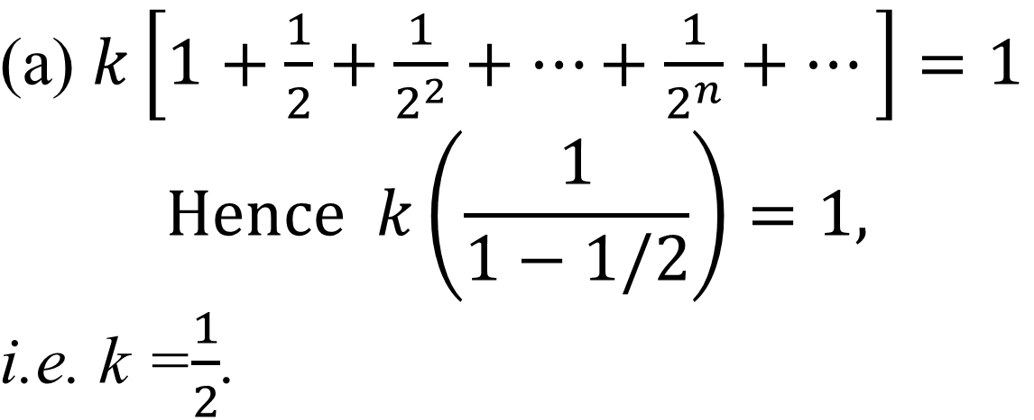
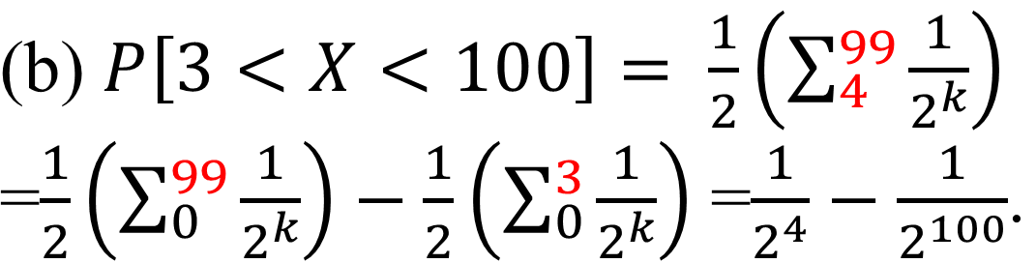

Slide 10
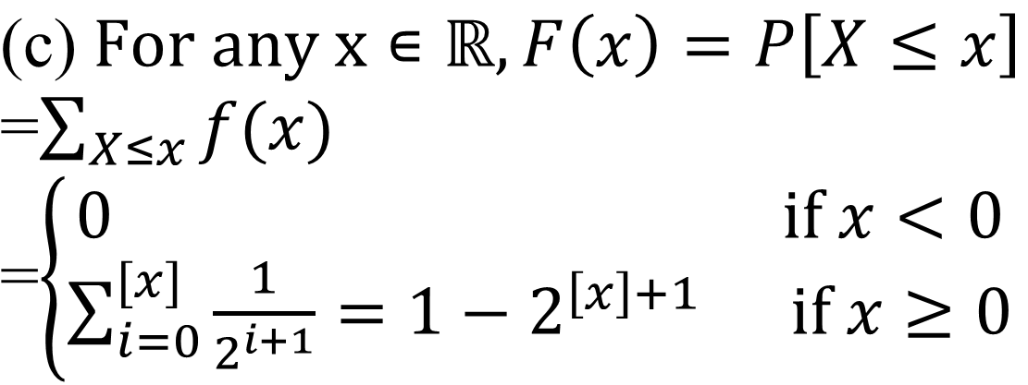

Slide 11
Tabular way of defining density :
Can tabulate values of density at points
where it is nonzero.
Tabular way of defining cumulative
distribution function : Can tabulate values
of F(x) where steps change.

Slide 12
Exercise 10 : It is known that the probability of
being able to log on to a computer from a remote
terminal at any given time is 0.7. Let X denote
the number of attempts that must be made to gain
access to the computer.
Find the first 4 terms of the density table.
Find a closed form expression for f(x).
Find P[X=6]
Find a closed form expression for F(x).
Use F to find the probability that at most 4
attempts are required to access the computer.

Slide 13
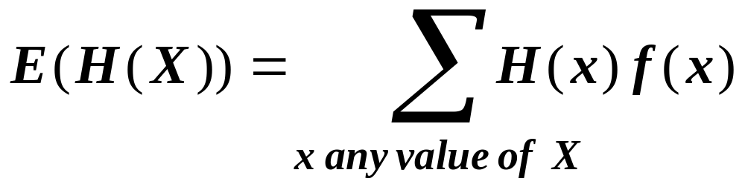
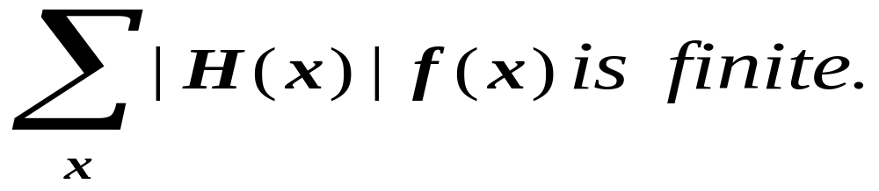
Expectations :
Defn : Let X be a discrete random variable and
H(X) be a function of X. Then the expected
value of H(X), denoted by E(H(X)), is defined by
Where f(x) is density of X provided

Slide 14
Notes :
E[H(X)] can be interpreted as the average
value of H(X).
If ∑ _{all x}|H(x)|f(x) diverges then E[H(X)] does
not exist irrespective of convergence of
∑ _{all x}H(x)f(x), see Ex. 22.
E[X] measures average value of X and is
called the mean of X and denoted by μ_{X} or μ
Distribution is scattered around μ. Thus it
indicates location of center of values of X and
hence called a location parameter.

Slide 15
Variance and Standard deviation
Defn : If a discrete random variable X has mean μ, its variance Var(X) or σ² is defined by
Var(X) = E[(X-μ)²].
The standard deviation σ is the nonnegative square root of Var(X).

Slide 16
Notes :
Note that Var(X) is always nonnegative,
if it exists.
Variance measures the dispersion or
variability of X. It is large if values of X away
from μ have large probability, I.e. values of X
are more likely to be spread. This indicates
inconsistency or instability of random variable.

Slide 17
Properties of mean
Theorem : If X is a random variable and c is a real number then :
E[c]=c and E[cX]= cE[X].
Proof : E[c] = ∑c f(x) = c ∑f(x)=c(1)=c.
E[cX]= ∑c xf(x) = c ∑xf(x)=cE[X].
Ex.: Prove for reals a,b, E[aX+b]=aE[X]+b.

Slide 18
Properties of variance
Theorem : Var[X]=e[X²]-μ_{X}².
Theorem : For a real number c,
Var[c] = 0 and Var [cX]=c²Var[X].

Slide 19
Exercise 15 : The density for X, the number of
holes that can be drilled per bit while drilling
into limestone is given by the following table :
x | 1 | 2 | 3 | 4 | 5 | 6 | 7 | 8
f(x) | .02 | .03 | .05 | .2 | .4 | .2 | .07 | ?
Find E[X], E[X²], Var[X], σ_{X}. Find the unit
of σ_{X}.
Note that ? = 0.03.

Slide 20
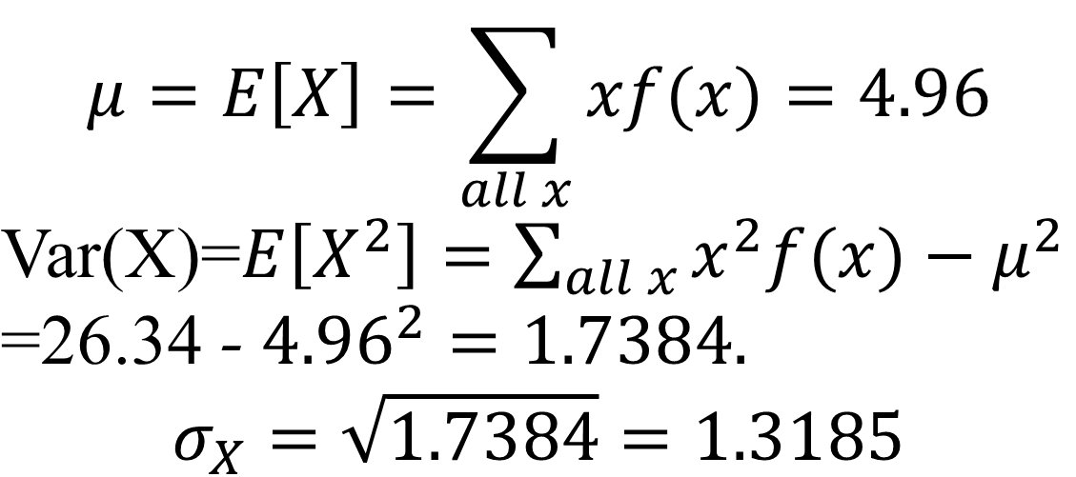
x | 1 | 2 | 3 | 4 | 5 | 6 | 7 | 8
f(x) | .02 | .03 | .05 | .2 | .4 | .2 | .07 | .03
xf(x) | .02 | .06 | .15 | .8 | 2 | 1.2 | .49 | .24
x²f(x) | .02 | .12 | .45 | 3.2 | 10 | 7.2 | 3.43 | 1.92

Slide 21
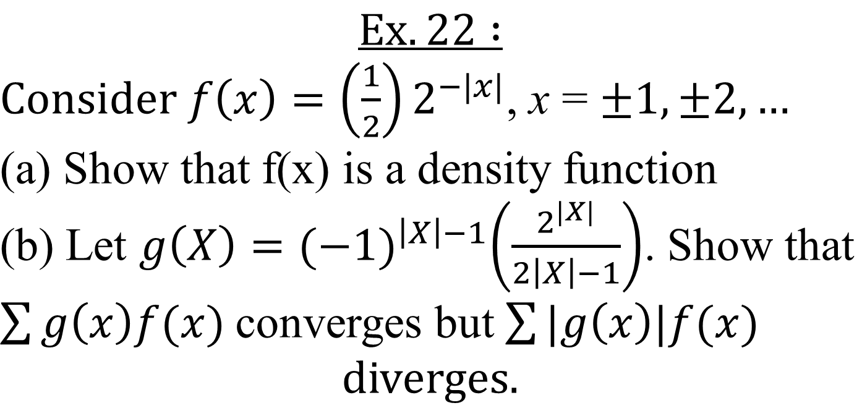

Slide 22
Ordinary Moments : For any positive integer k,
the k^{th} ordinary moment of a discrete random
variable X with density f(x) is defined to be
E[X^{k}].
Thus for k=1 we get mean.
Using 1st and 2nd ordinary moment, we can
evaluate variance.
There is a tool, moment generating function
(m.g.f) which helps to evaluate all ordinary
moments in one go.

Slide 23
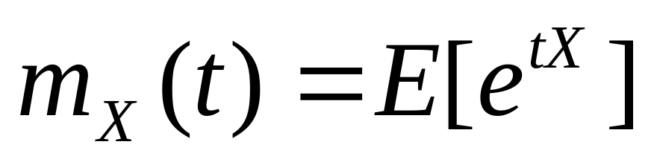
Moment generating function
Definition : Let X be any random variable with density f. The m.g.f. for X is denoted by m_{X}(t) and is given by
provided the expectation is finite for all real numbers t in some open interval (-h, h).

Slide 24
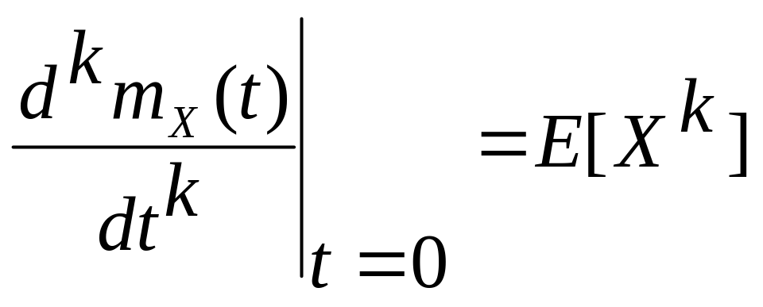
Theorem :If m_{X}(t) is the m.g.f. for a random
variable X, then

Slide 25
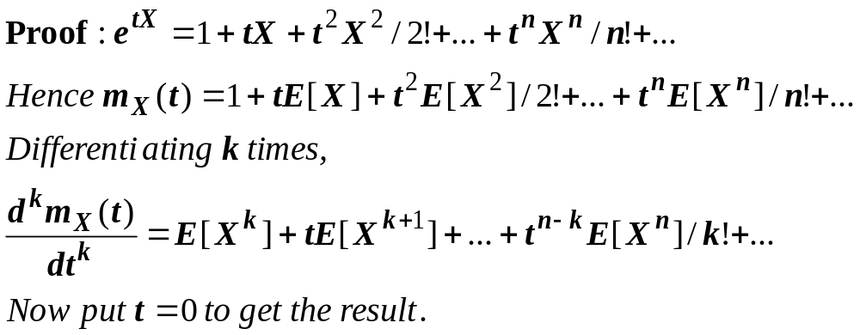


Slide 26
Bernoulli trials
A trial which has exactly 2 possible outcomes, success s and failure f, is called Bernoulli trial.
For any random experiment, if we are only interested in occurrence or not of a particular event, we can treat it as Bernoulli trial.
Thus if we toss a dice but are interested in whether top face has even number or not, we can treat it as a Bernoulli trial.

Slide 27
Geometric distribution
If we perform a series of identical and independent trials, X = number of trials required to get the first success is a discrete random variable called geometric random variable. Its probability distribution is called geometric distribution.

Slide 28
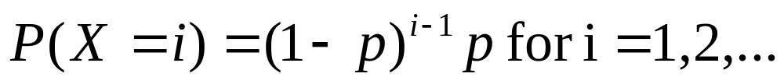
Sample space of this expt is {s, fs, ffs, fffs, …}.
Probability of success on any trial =p is same.

Slide 29
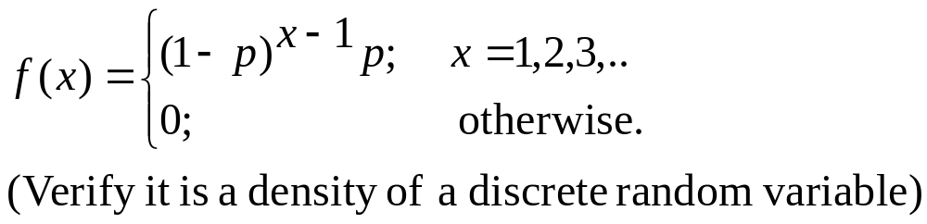
In fact the function f is called the density of a
geometric distribution with parameter p for
0 < p < 1 if

Slide 30
We write q = 1-p. Then c.d.f. of geometric
distribution is F(x) = 1-q^{[x]} for any real x>0
and 0 otherwise.

Slide 31
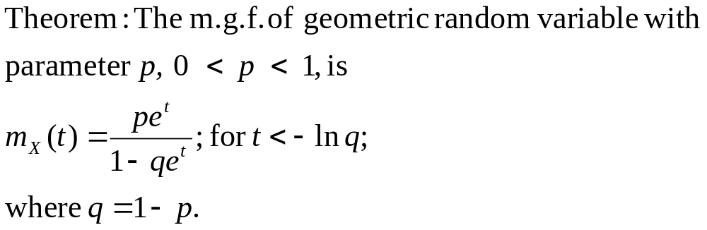

Slide 32
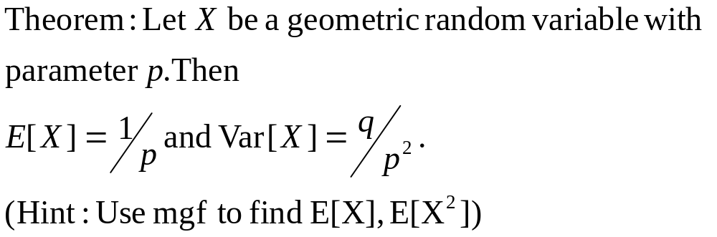
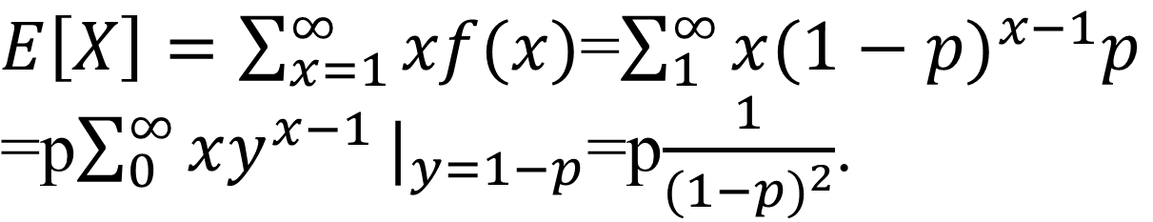
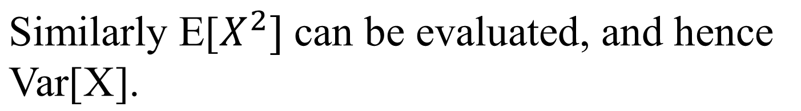
Proof (without mgf):

Slide 33
Exercise 25 : The zinc phosphate coating on the threads of steel tubes used in oil and gas wells is critical to their performance. To monitor the coating process, an uncoated metal sample with known outside area is weighed and treated along with the lot of tubing. This sample is then stripped and reweighed. From this it is possible to determine whether or not the proper amount of coating was applied to the tubing.

Slide 34
Assume that the probability that a given lot is unacceptable is 0.05. Let X denote the number of runs conducted to produce an unacceptable lot. Assume that the runs are independent in the sense that the outcome of one run has no effect on that of any other. Verify X is geometric. What is success? p=?
What is density, E[X], E[X²], σ²? M.g.f.? Find the probability that the number of runs required to produce an unacceptable lot is at least 3.

Slide 35
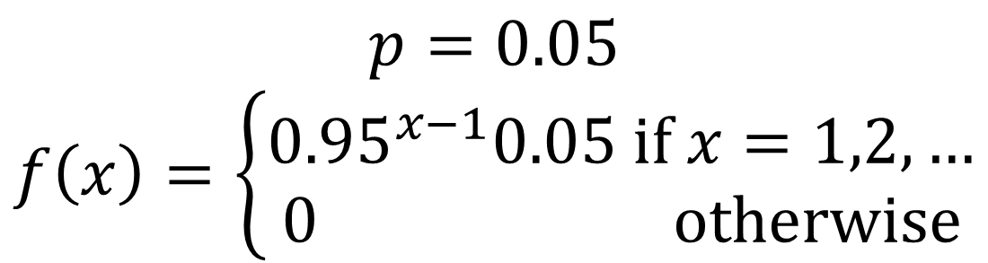
Bernoulli trial : follow the procedure for a
Particular lot to see if it is unacceptable (success)
If the lots are picked randomly from large
population, trials are indep.
X = number of Bernoulli trials for the 1st success.

Slide 36
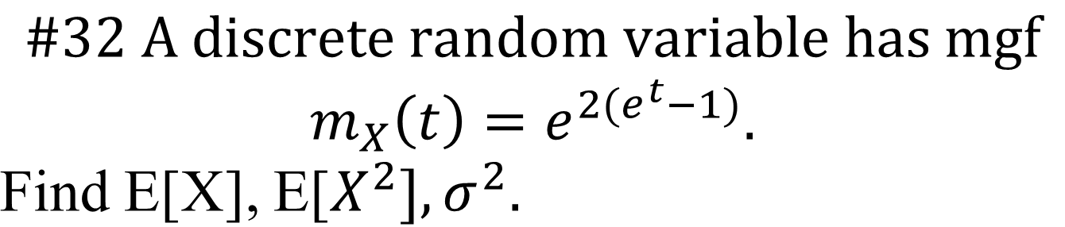

Slide 37
#33. A quality engineer is monitoring a process
that produces timing belts for automobiles. Each
hr he samples 4 belts form production line and
determines the average breaking strength for the
sample. If the average is too low, signifies process
is not operating correctly. Assume prob of getting
a sample with too low average is 0.025 and prob
remains same for each sample drawn.
Show : X = no. of samples drawn to get first
sample with too low an average, has geom dist.
© On average how many samples will be drawn
To get a first sample with too low average?

Slide 38
Binomial distribution
Let an expt consist of fixed number n of Bernoulli trials.
Assume all trials are identical and independent. Thus p = probability of success is same on any trial.
X= number of successes in these n trials.
What is P(X=x)?

Slide 39
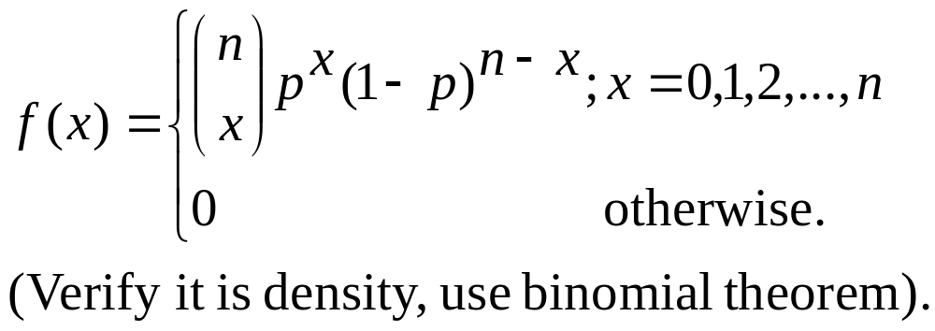
A discrete random variable X has binomial distribution with parameters n and p, n is a positive integer and 0<p<1,
if its density function is

Slide 40
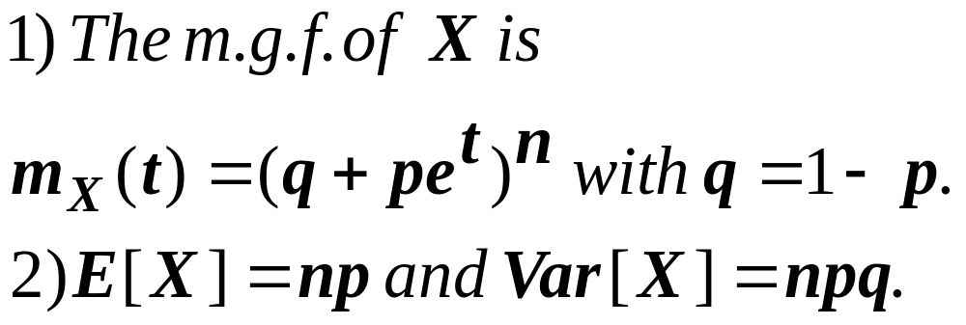
Theorem : Let X be a binomial random variable with parameters n and p. Then

Slide 41
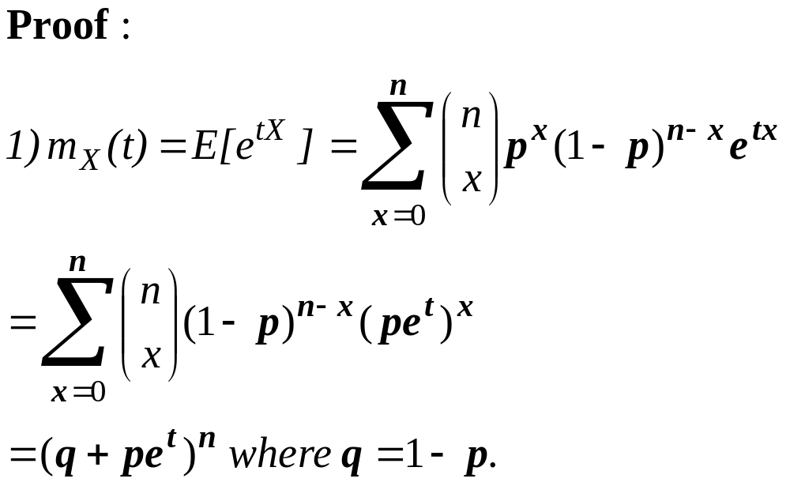

Slide 42
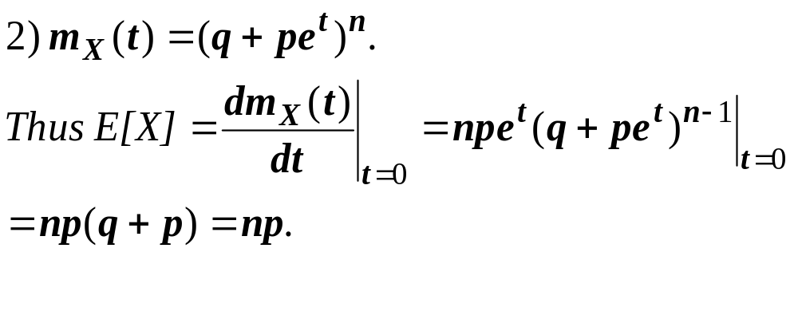

Slide 43
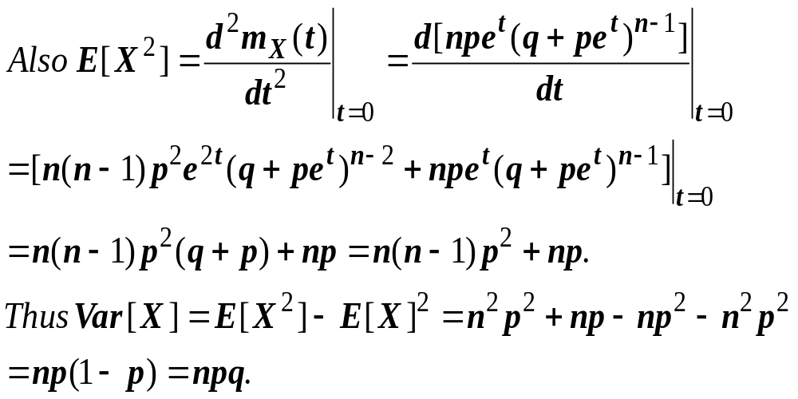

Slide 44
c.d.f. of binomial distribution
It is difficult to write explicit formula.
So values are given in Table I App. A, p. 687-690.

Slide 45
From c.d.f., we can find density :f(x)=F(x)-F(x-1) if x =0,1,2,…,n.
P(a ≤ X ≤b)=F(b)-F(a-1) for integers a, b.

Slide 46
Example 3.5.3 : Let X denote the number of
Radar signals properly identified in a 30 minute
time period in which 10 signals are received.
Assuming that any signal is identified with
probability p=1/2 and identification of signals is
independent of each other find the probability
that at most seven signals are identified correctly

Slide 47
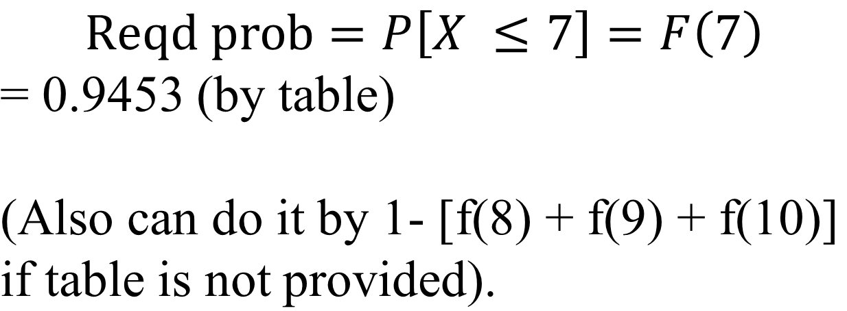
X = number of radar signals properly identified
(out of 10 signals received)
X has a binomial dist with parameters
n = 10, p = 0.5.

Slide 48
#41 It has been found that 80% of all printers
used on home computers operate correctly at
the time of installation. The rest require some
adjustment. A particular dealer sells 10 units
during a given month.
Find the probability that at least 9 of the
printers operate correctly upon installation.
(b) Consider 5 months in which 10 units are
sold per month. What is the probability that at
least 9 units operate correctly in each of the
5 months.

Slide 49
#42 It is possible for a computer to pick an erroneous signal that does not show up as an error on the screen. The error is called a silent paging error. A particular terminal is defective, and when using the system word processor, it introduces a silent page error with probability 0.1. The word processor is used 20 times during a week.
(a)Find the probability that no silent paging errors occur.
(b) Find the probability that at least one such error occurs.
(c) Would it be unusual for more than 4 such errors to occur? Explain based on probabilities involved.

Slide 50
#45 (Point binomial or Bernoulli dist).
Assume an experiment is conducted and the outcome
is considered to be either a success or a failure. Let p
denote the probability of a success. Define
X to be 1 of the outcome is a success and 0 if it is a
failure. X is said to have a point binomial or Bernoulli
distribution with parameter p.
Argue that X has a binomial r.v. with n =1.
Find the density of X
Find mgf of X.
Find the mean and variance of X.

Slide 51
(e) In DNA replication errors can occur that are
chemically induced. Some of these errors are “silent” in that they do not lead to an observable mutation. Growing bacteria are exposed to a chemical that has probability of 0.14 of inducing an observable error. Let X be 1 if an observable mutation results and 0 otherwise. Find E[X].

Slide 52
Sampling with replacement : If we choose
randomly with replacement a sample of n
objects from N objects of which r are favorable
and X= number of favorable objects in the
sample chosen then X has binomial
distribution with parameters n and p=r/N.

Slide 53
Ex : From a usual pack of 52 cards, 10 cards are picked randomly with replacement. Find the probability that they will contain at least 4 and at most 7 spades.
Identify Bernoulli trials and success and random variable X together with its distribution.
n=10, p=0.25.
Required probability = F(7)-F(3) = 0.9996- 0.7759(By tables)

Slide 54
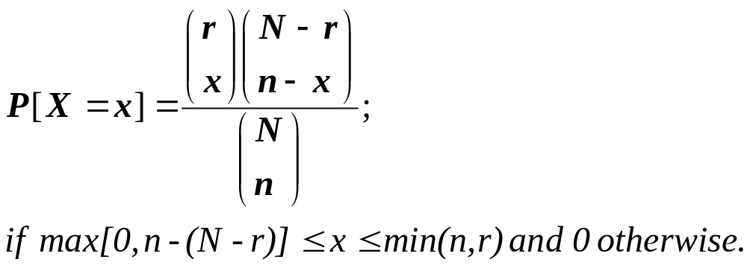
Hypergeometric distribution
If we are choosing without replacement a sample of size n from N objects of which r are favorable, and X=number of favorable objects in the sample, then

Slide 55
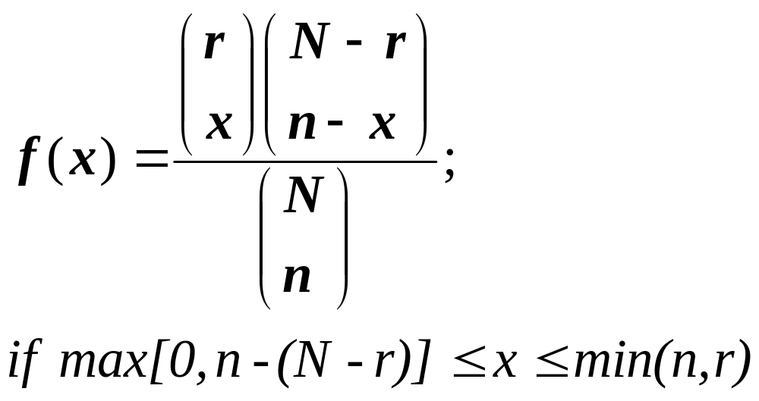
Definition :A random variable X with integer
values has a hypergeometric distribution with
parameters N, n, r if its density is

Slide 56
Theorem : If X is a hypergeometric random
variable with parameters N, n, r then
E[X] = n(r / N)
Var[X] = n (r / N) [(N-r) / N] [(N-n) / (N-1)]

Slide 57
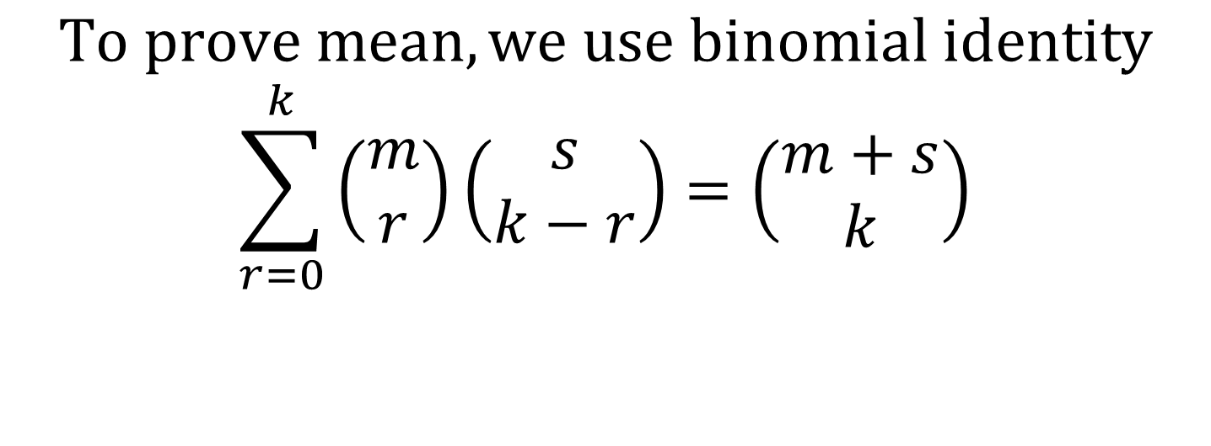
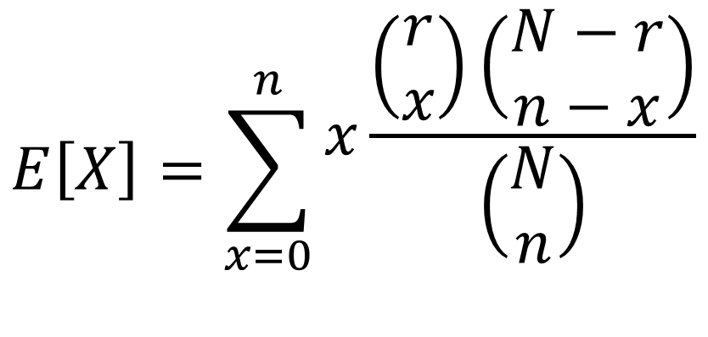

Slide 58
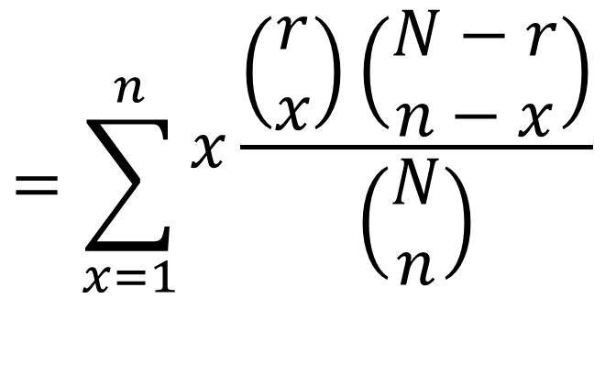
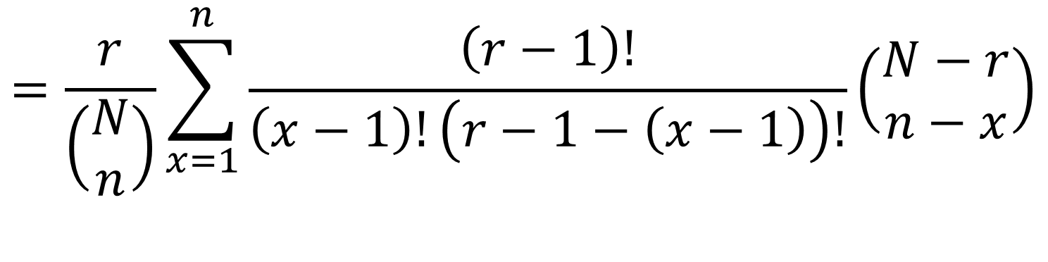
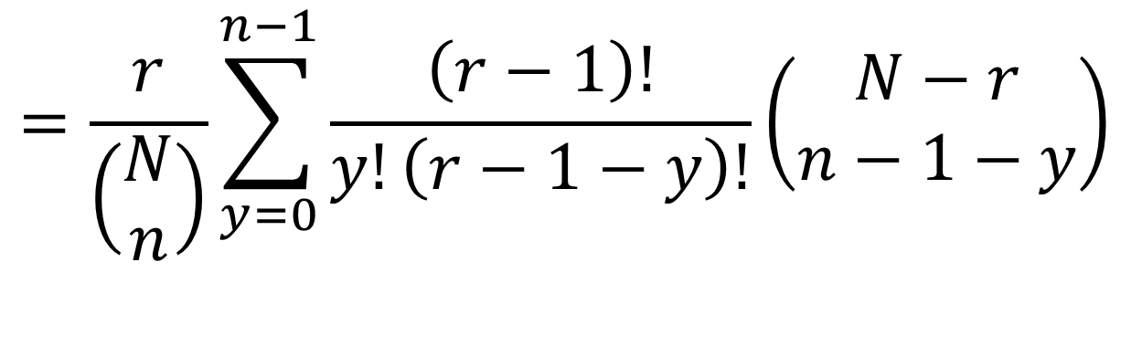

Slide 59
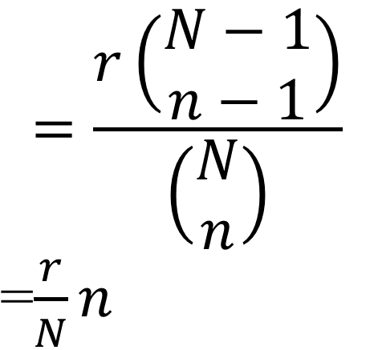
Variance formula will not be proved.

Slide 60
Hypergeometric binomial
When the sample size n is small compared to population size N, we can use binomial distribution even when sampling is without replacement.
This is done if n/N ≤ 0.05. The parameters are n and p=r/N.

Slide 61
Example 3.7.3 :During a course of an hour, 1000 bottles of beer are filled by a particular machine. Each hour a sample of 20 bottles is randomly selected and number of ounces of beer per bottle is checked. Let X denote the number of bottles selected that are underfilled. Suppose during a particular hour, 100 underfilled bottles are produced. Find the probability that at least 3 underfilled bottles will be among those sampled.

Slide 62
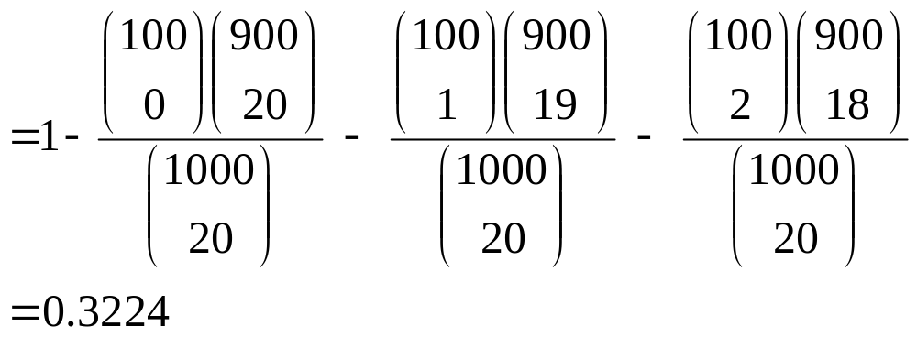
Solution (using hypergeometric)
Required probability = P[X ≥3]
= 1-P[X =0] – P[X=1] – P[X=2]

Slide 63
(Binomial distribution with n= 20,
p= 100/1000 = 0.1)
P[X≥3] = 1-F(2) = 1-0.6769 = 0.3231.

Slide 64
Sometimes population size is large but not known. Proportion of favorable population is given. Then we can use binomial distribution for both sampling with or without replacement where p is the proportion of favorable population.

Slide 65
Ex : A vegetable vendor has a large pile of tomatoes of which 30% are green. A buyer randomly puts 10 tomatoes randomly in his basket. What is the probability that more than 5 of them are green?

Slide 66
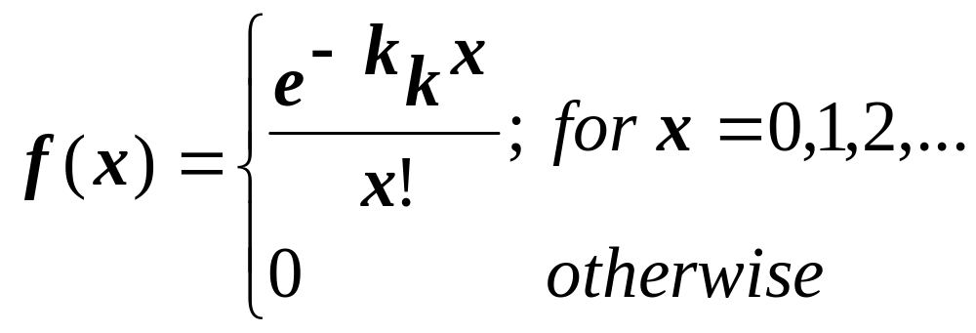
Poisson Distribution
Let k > 0 be a constant and, for any real number x,
Theorem : f is a density function.

Slide 67
A random variable X with this density f is said
to have a Poisson distribution with parameter k.

Slide 68
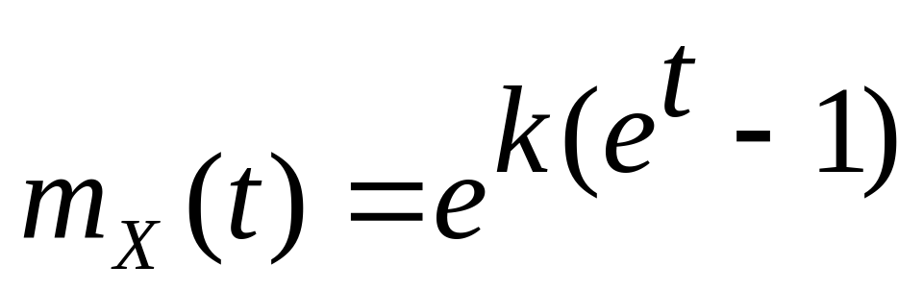
Theorem : The m.g.f. of a Poisson random
variable X with parameter k>0 is
E[X]=k and Var[X]=k.

Slide 70
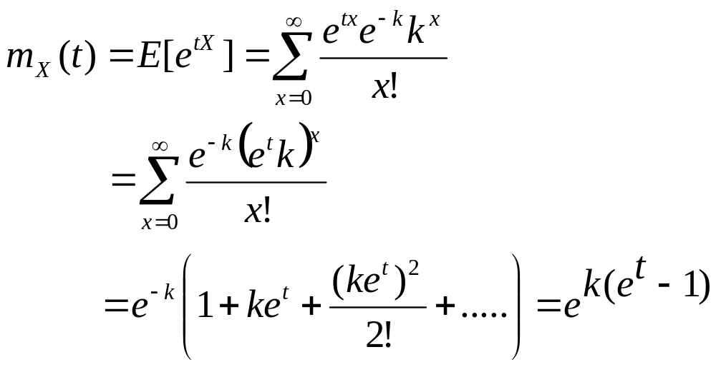
Proof:

Slide 71
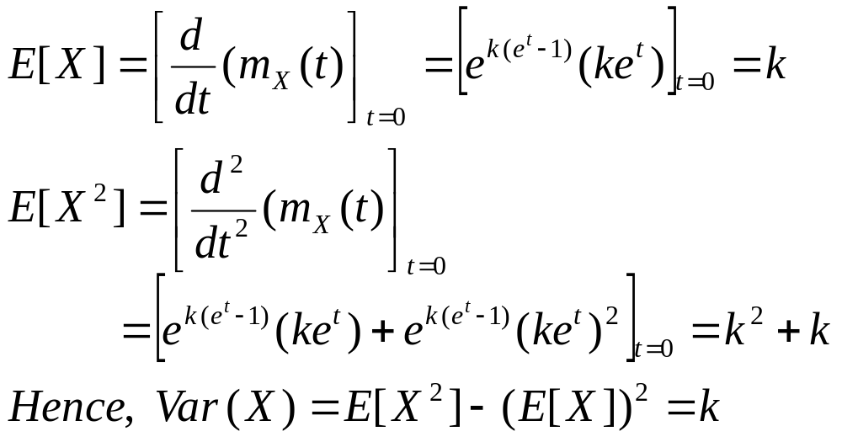

Slide 72
Poisson approx to binomial :
If a binomial random variable X has parameter p
very small and n large so that np = k is
moderate then X can be approximated by a
Poisson random variable Y with parameter k.

Slide 73
Poisson Process : A process occurring discretely over a continuous interval of time or length or space is called a Poisson Process.
Let λ = average number of successes occurring in a unit interval.

Slide 74
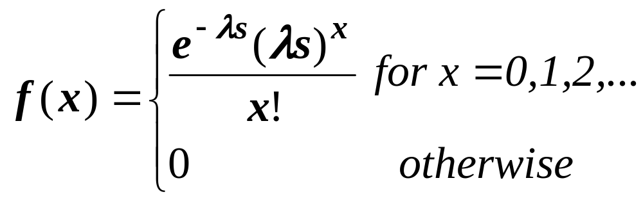
Let X = number of times the discrete event
occurs in a given interval of length s in a
Poisson process.
Then X has Poisson distribution with parameter
k= λs.
Thus density of X is :

Slide 75
Steps in solving Poisson Problem
Determine the basic unit of measurement being used.
Determine the average number of occurrences of the event per unit. This number is denoted by λ.
The random variable X, the number of occurrences of the event in the interval of size s follows a Poisson distribution with parameter k = λs.

Slide 76
c.d.f. of Poisson distribution
Provided by Table on p.692.
Values of k=λs, the parameter of Poisson distribution corresponds to columns, values t of random variable correspond to rows and value of cdf F(t) are entries inside table.

Slide 77
Exercise 63 :Geophysicists determine the age of
a zircon by counting the number of uranium
fission tracks on a polished surface. A particular
zircon is of such an age that the average number
of tracks per square centimeter is five. What is
the probability that a 2 centimeter-square sample
of this zircon will reveal at most 3 tracks, thus
leading to an underestimation of the age of the
Material?

Slide 78
Random variable X = number of uranium
fission tracks in the (specific) 2
centimeter-square sample of zircon.
X has Poisson distribution with parameter
k = sλ = (2)(5)=10.
Required probability = F(3) = 0.010

Slide 79
Ex.64 : California is hit by approximately 500
Earthquakes that are large enough to be felt every
year. However those of destructive magnitude
occur on an average once a year. Find the
probability that at least one earthquake of this
magnitude occurs during a 6 month period.
Would it be unusual to have 3 or more
earthquakes of destructive magnitude on a 6
month Period? Explain.

